Slide 1
A STUDENT GUIDE
The Nine Keys of Simi Valley
An English Treasure Hunt
Nine real Simi Valley locations. Nine business-English lessons. One word hidden inside the objects you win.
How to use the hunt, step by step

Slide 2
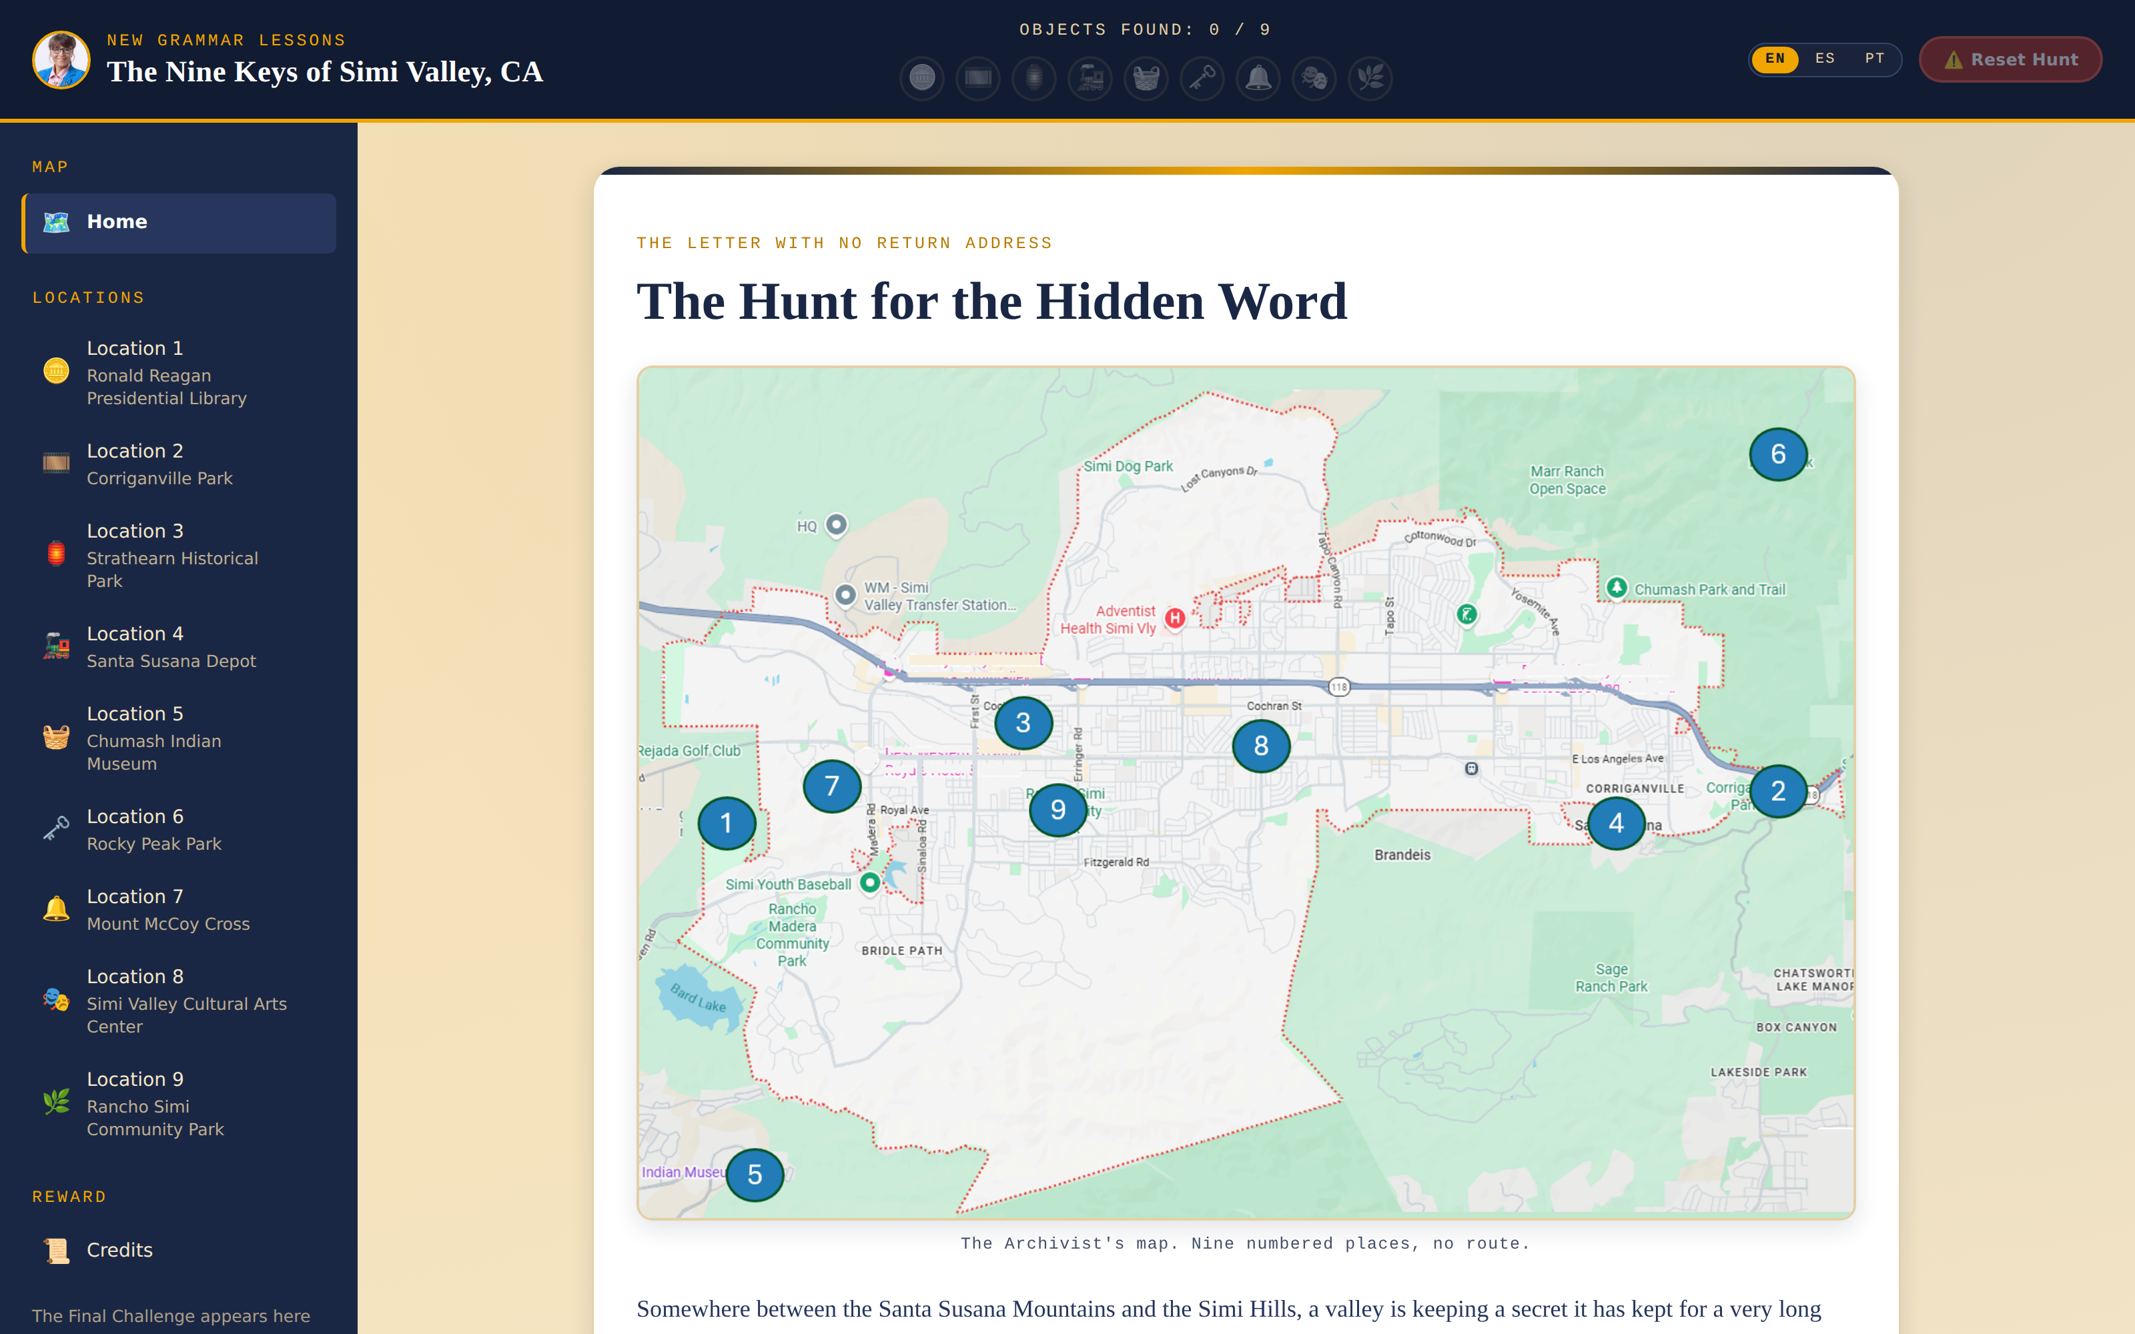
WHAT IS THIS PRODUCT
A grammar course disguised
as a treasure hunt
Nine real locations around Simi Valley, California — each one hiding an object.
Every object is guarded by a short business-English lesson and a mini-game. Clear ten rounds and the object is yours.
Collect all nine objects and their letters spell one final hidden word.
There is no required order — a student can start at any of the nine locations.
The Nine Keys of Simi Valley · Student Guide
2

Slide 3
THE TEACHING METHOD
Two verb families, one simple rule
V1 — “THE GODFATHER”
V2 — EVERY ACTION VERB
The verb to be.
Weak on its own.
Strong on its own. Needs no helper. Is always followed by a noun.
Needs a helper (Did / Do / Does / Will) to ask a question, and turns noun-like with -ing or -ed next to V1.
Together they build the Rule of Seven — Subject + Verb + Noun — presented as the formula behind roughly 95% of everyday English answers.
The method rests on TPR (Total Physical Response): every new word is paired with a movement or an image, training fast recall instead of slow translation.
The Nine Keys of Simi Valley · Student Guide
3

Slide 4
HOW THE HUNT IS ORGANIZED
Nine locations, nine lessons, any order
# | Location | Grammar topic | Hidden object
1 | Ronald Reagan Presidential Library | Movement First | Silver Speech Coin
2 | Corriganville Park | Two Kinds of Verb | Ironwood Film Reel
3 | Strathearn Historical Park | The Rule of Seven | Miner's Brass Lantern
4 | Santa Susana Depot | V1 in Detail | Iron Rail Whistle
5 | Chumash Indian Museum | V2 in Detail | Valley Rain Basket
6 | Rocky Peak Park | The Other Helpers | Amber Sandstone Key
7 | Mount McCoy Cross | The Small Rules | Hilltop Bell
8 | Simi Valley Cultural Arts Center | The Sound of American English | Echo Stage Mask
9 | Rancho Simi Community Park | Words You Can Actually Use | Yucca Seed Medallion
Collect all nine objects to unlock the final word waiting under the hunt.
The Nine Keys of Simi Valley · Student Guide
4

Slide 5
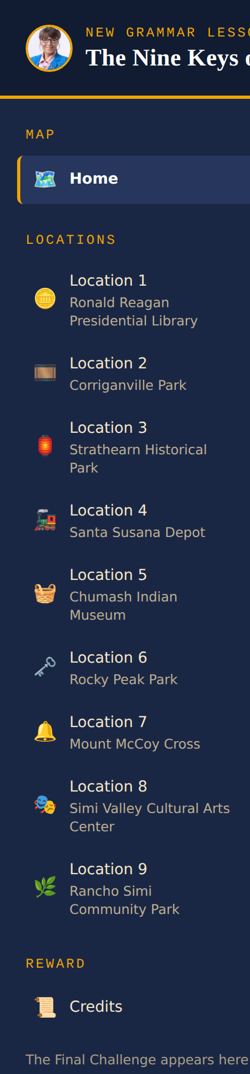
1
OPEN THE MAP AND CHOOSE A LOCATION
From the Home screen, use the left-hand menu to browse all nine locations.
Click Explore on any location card. There is no fixed starting point — pick the one that looks most interesting to you.
Each location shows a small object icon and its current status: Not visited or completed.
The Credits entry at the bottom of the menu explains the method itself — visit it any time.
The Nine Keys of Simi Valley · Student Guide
5

Slide 6
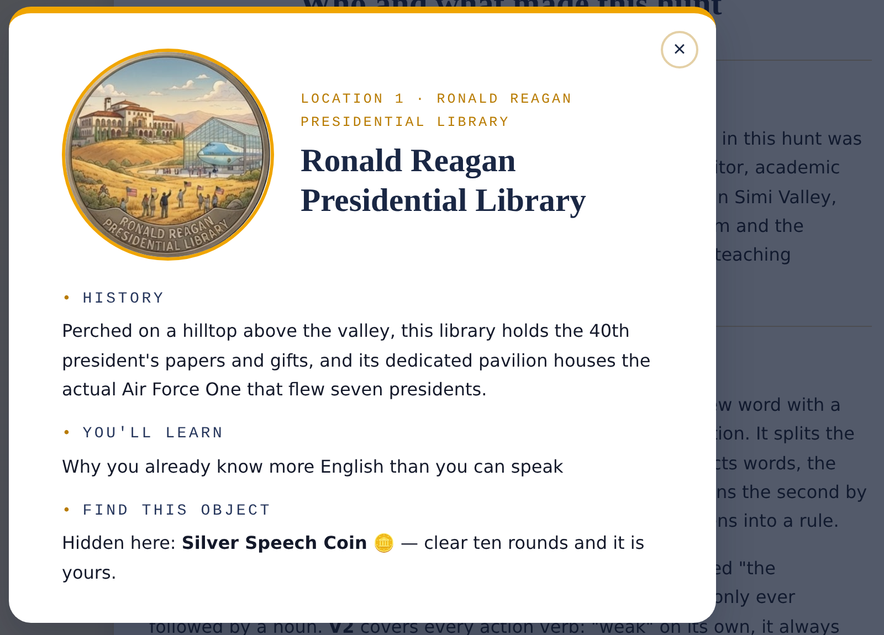
2
LEARN ABOUT THE LOCATION
Click the info icon (ℹ️) next to any location name to open its detail card.
History gives real background on the real place you are visiting.
You'll Learn previews the grammar topic waiting for you at this stop.
Find This Object tells you exactly what you are hunting for.
The Nine Keys of Simi Valley · Student Guide
6

Slide 7
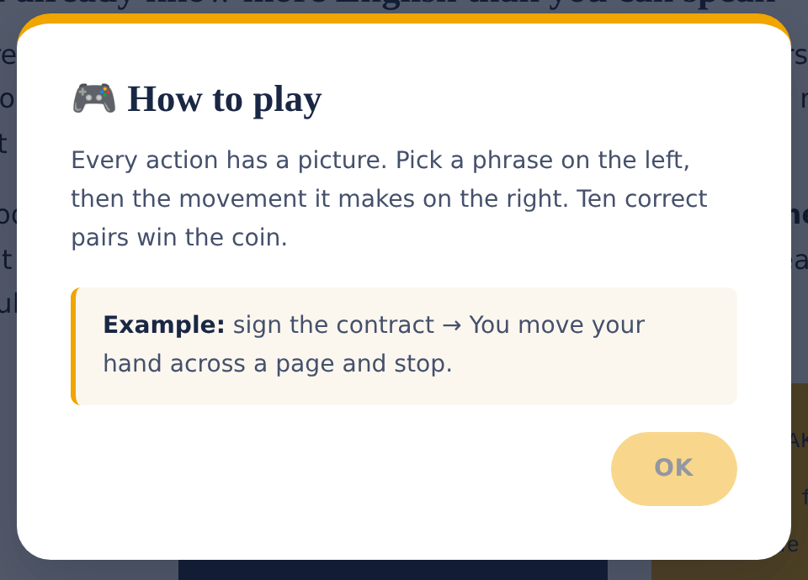
3
READ “HOW TO PLAY” FIRST
Every location opens with a short How to play popup — read it before you start.
It explains the exact mechanic for that location: matching, typing, choosing, or speaking.
An Example line always shows one full round already solved for you.
Reopen this popup any time with the “How to play” button beside the game.
The Nine Keys of Simi Valley · Student Guide
7

Slide 8
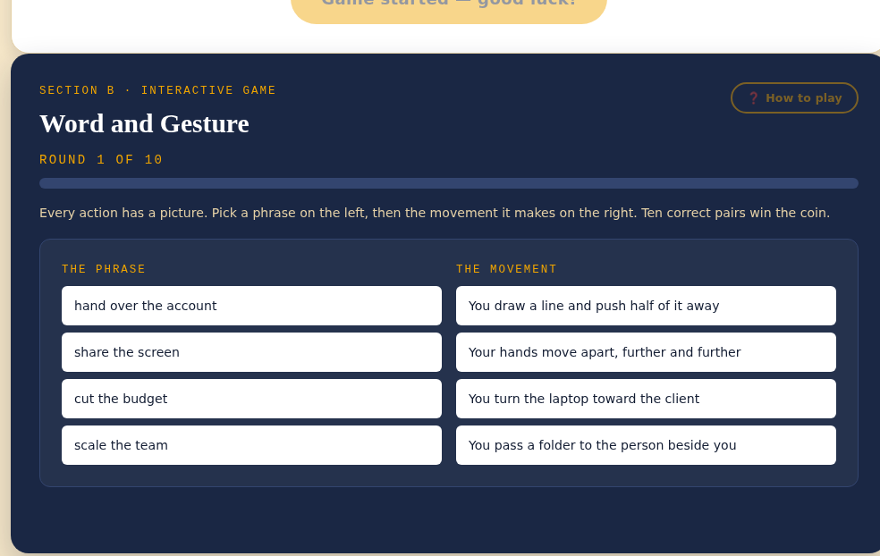
4
STUDY THE LESSON, THEN PLAY
Read the grammar lesson above the game — short, and written for working adults, not for a classroom.
Scroll down to Section B · Interactive Game to reach the mini-game itself.
A round counter (Round 1 of 10) tracks how far you are in the current challenge.
Clear all ten rounds to win the object hidden at that location.
The Nine Keys of Simi Valley · Student Guide
8

Slide 9
NINE LOCATIONS, IN DETAIL
Four pages for every location
Each location gets four pages here: the grammar lesson with a short summary, how to play its mini-game with a worked example, the in-game help popup you can reopen anytime, and the location's own info card.
The Nine Keys of Simi Valley · Student Guide
9

Slide 10
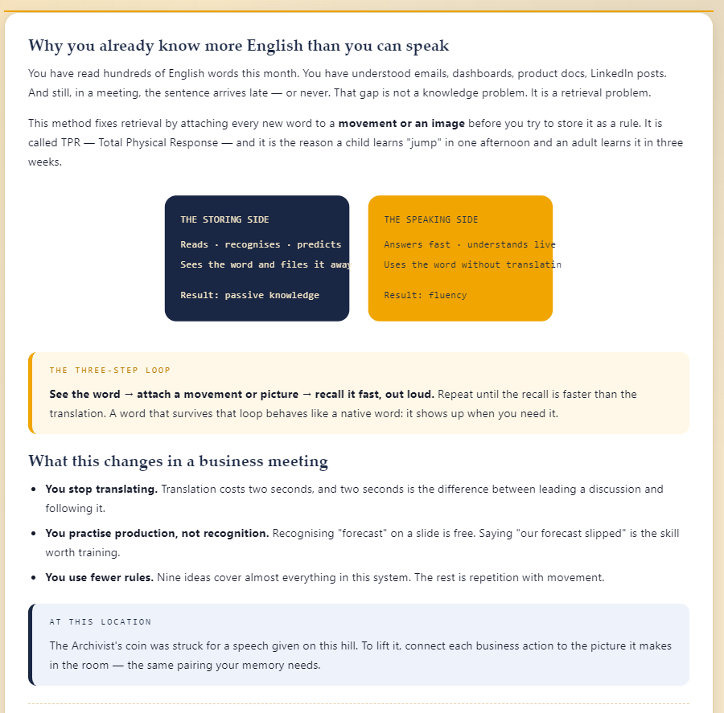
LOCATION 1 OF 9 · THE LESSON
Ronald Reagan Presidential Library
Why you already know more English than you can speak
You already recognize far more English than you can produce on the spot — that gap is retrieval, not knowledge. The fix is TPR: pair every new phrase with a movement or image, then recall it fast and out loud until it responds like a native word.
The Nine Keys of Simi Valley · Student Guide
10

Slide 11
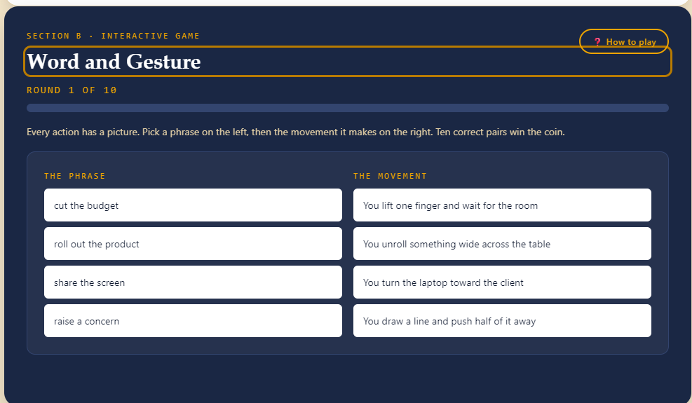
LOCATION 1 OF 9 · HOW TO PLAY
Ronald Reagan Presidential Library
Why you already know more English than you can speak
HOW TO PLAY
Every action has a picture. Pick a phrase on the left, then the movement it makes on the right. Ten correct pairs win the coin.
EXAMPLE
sign the contract → You move your hand across a page and stop.
Hidden object: Silver Speech Coin 🪙
The Nine Keys of Simi Valley · Student Guide
11

Slide 12
LOCATION 1 OF 9 · HELP, ANYTIME
Ronald Reagan Presidential Library
Why you already know more English than you can speak
The “How to play” button beside the game reopens this same popup at any point during a round — the mechanic and one worked example, without losing your progress.
The Nine Keys of Simi Valley · Student Guide
12

Slide 13
LOCATION 1 OF 9 · ABOUT THIS PLACE
Ronald Reagan Presidential Library
Why you already know more English than you can speak
Tap the info icon (ℹ️) next to any location on the map to open this card — real history behind the place, the grammar topic waiting for you, and the object you are hunting for.
The Nine Keys of Simi Valley · Student Guide
13

Slide 14
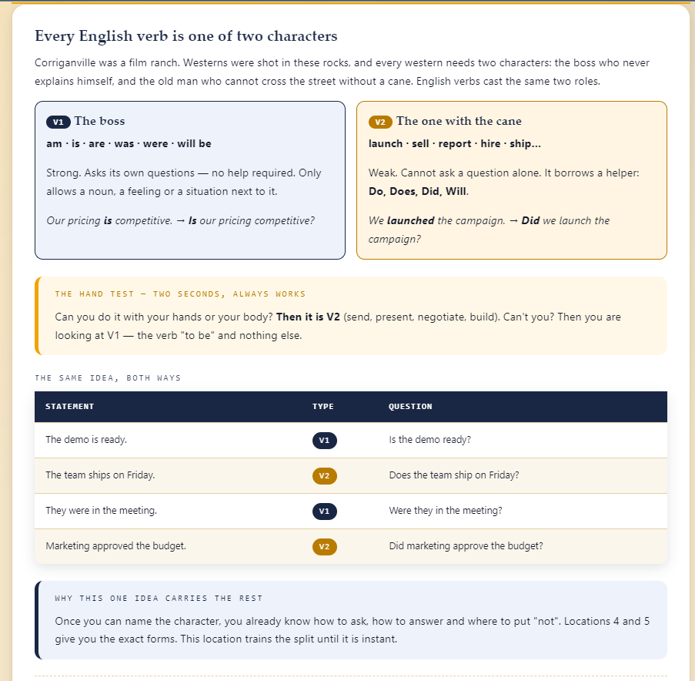
LOCATION 2 OF 9 · THE LESSON
Corriganville Park
Every English verb is one of two characters
Every English verb is either V1 (the verb “to be” — strong, and able to ask its own questions) or V2 (every action verb — weak, and dependent on a helper like Do / Does / Did / Will). A quick hand test settles which one you are dealing with: can you do it with your hands or body?
The Nine Keys of Simi Valley · Student Guide
14

Slide 15
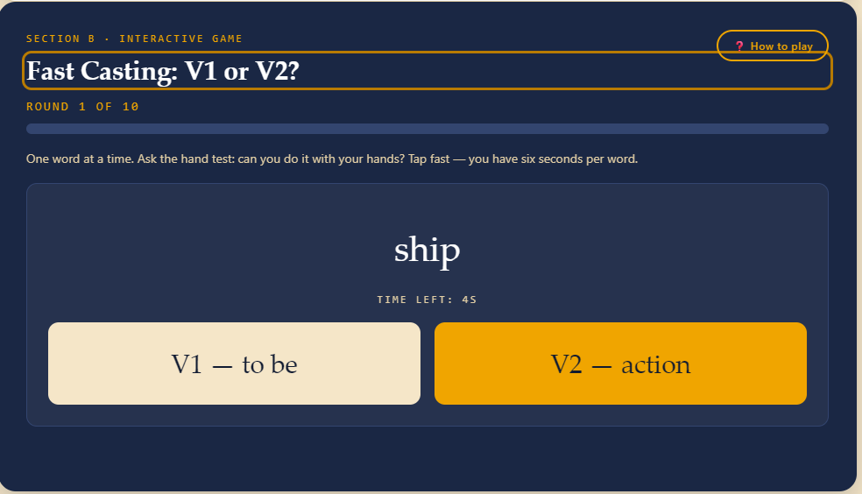
LOCATION 2 OF 9 · HOW TO PLAY
Corriganville Park
Every English verb is one of two characters
HOW TO PLAY
One word at a time. Ask the hand test: can you do it with your hands? Tap fast — you have six seconds per word.
EXAMPLE
launch → V2, an action verb (needs Do / Does / Did / Will). is → V1, no helper needed.
Hidden object: Ironwood Film Reel 🎞️
The Nine Keys of Simi Valley · Student Guide
15

Slide 16
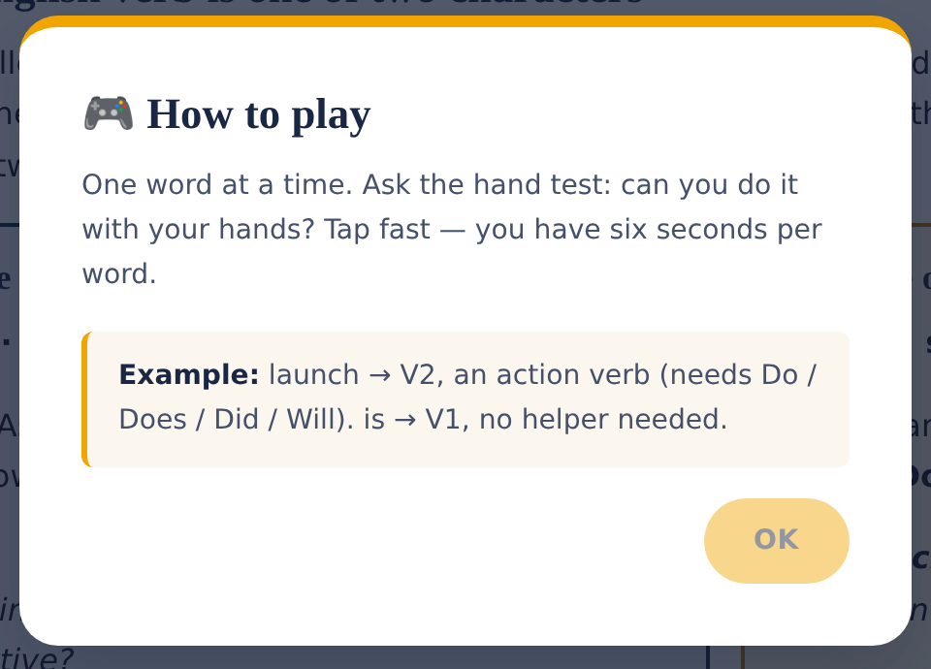
LOCATION 2 OF 9 · HELP, ANYTIME
Corriganville Park
Every English verb is one of two characters
The “How to play” button beside the game reopens this same popup at any point during a round — the mechanic and one worked example, without losing your progress.
The Nine Keys of Simi Valley · Student Guide
16

Slide 17
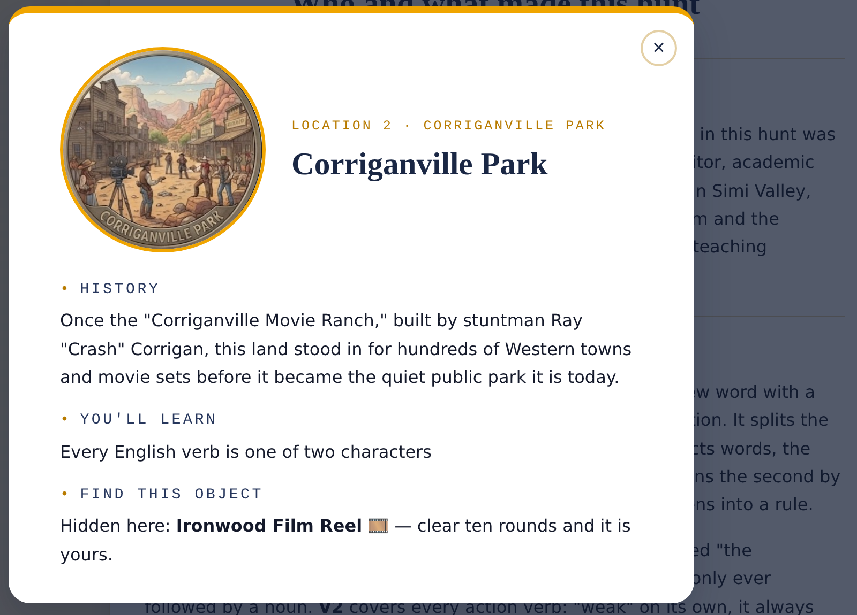
LOCATION 2 OF 9 · ABOUT THIS PLACE
Corriganville Park
Every English verb is one of two characters
Tap the info icon (ℹ️) next to any location on the map to open this card — real history behind the place, the grammar topic waiting for you, and the object you are hunting for.
The Nine Keys of Simi Valley · Student Guide
17

Slide 18
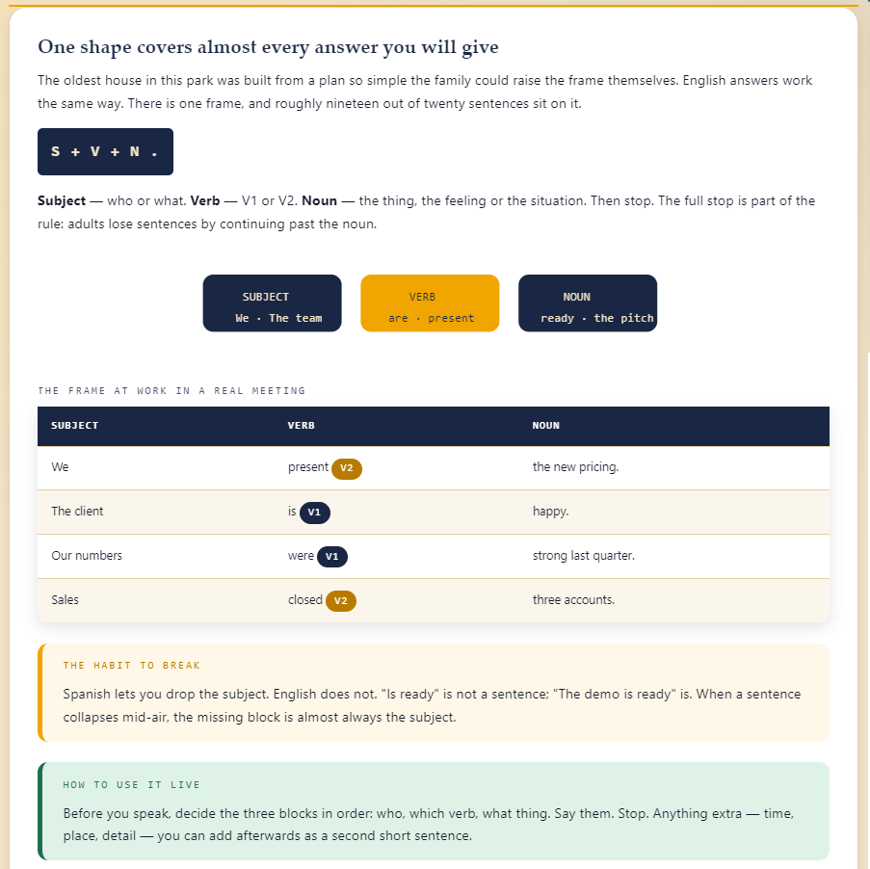
LOCATION 3 OF 9 · THE LESSON
Strathearn Historical Park
One shape covers almost every answer you will give
Nearly every English sentence fits one frame: Subject + Verb + Noun, then stop. Deciding the three blocks before you speak — who, which verb, what thing — is what keeps a sentence from collapsing mid-air, a habit Spanish's dropped subjects don't train.
The Nine Keys of Simi Valley · Student Guide
18

Slide 19
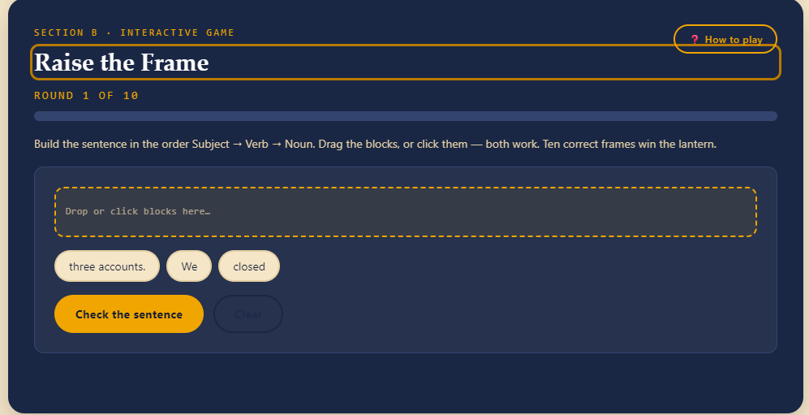
LOCATION 3 OF 9 · HOW TO PLAY
Strathearn Historical Park
One shape covers almost every answer you will give
HOW TO PLAY
Build the sentence in the order Subject → Verb → Noun. Drag the blocks, or click them — both work. Ten correct frames win the lantern.
EXAMPLE
The team | presents | the new pricing. → Subject, then V2, then the noun.
Hidden object: Miner's Brass Lantern 🏮
The Nine Keys of Simi Valley · Student Guide
19

Slide 20
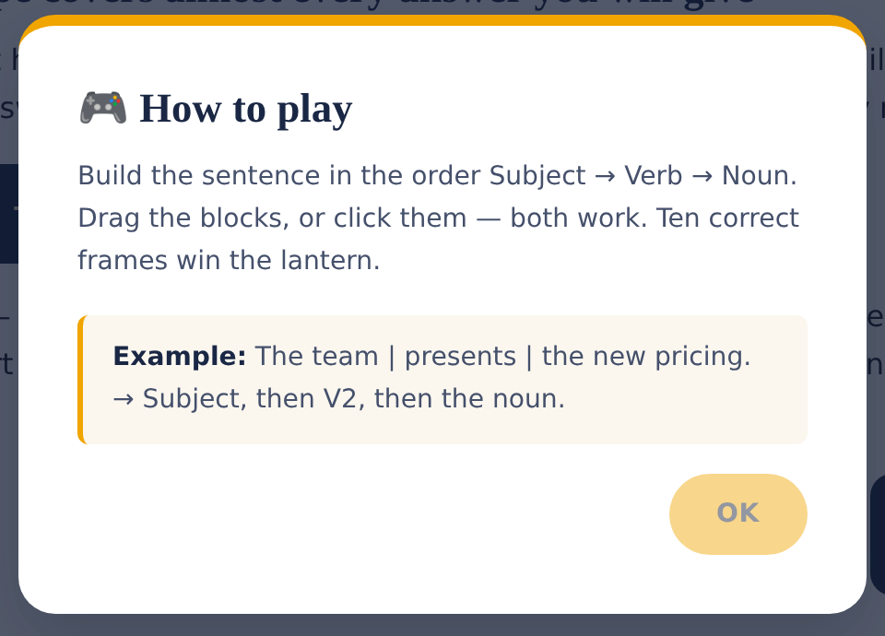
LOCATION 3 OF 9 · HELP, ANYTIME
Strathearn Historical Park
One shape covers almost every answer you will give
The “How to play” button beside the game reopens this same popup at any point during a round — the mechanic and one worked example, without losing your progress.
The Nine Keys of Simi Valley · Student Guide
20

Slide 21
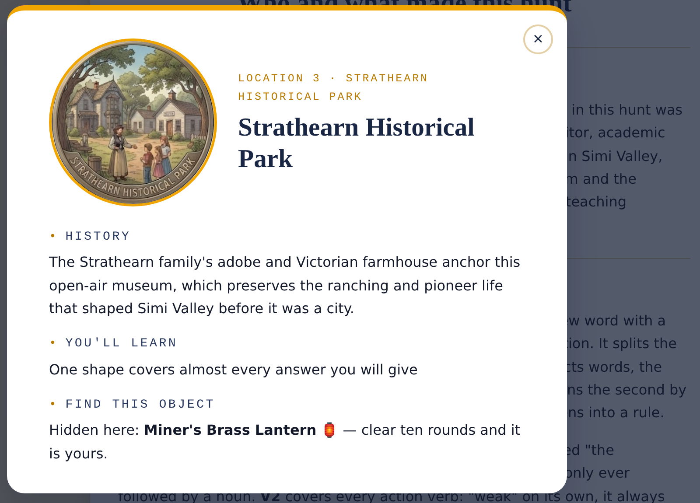
LOCATION 3 OF 9 · ABOUT THIS PLACE
Strathearn Historical Park
One shape covers almost every answer you will give
Tap the info icon (ℹ️) next to any location on the map to open this card — real history behind the place, the grammar topic waiting for you, and the object you are hunting for.
The Nine Keys of Simi Valley · Student Guide
21

Slide 22
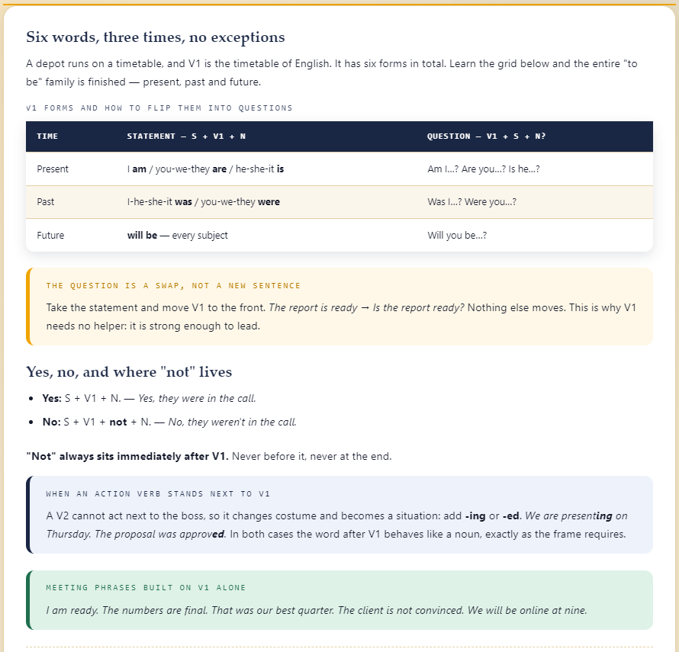
LOCATION 4 OF 9 · THE LESSON
Santa Susana Depot
Six words, three times, no exceptions
V1, the verb “to be,” has exactly six forms spread across present, past and future. Turning a statement into a question is a simple swap — move V1 to the front — which is exactly why V1 never needs a helper verb.
The Nine Keys of Simi Valley · Student Guide
22

Slide 23
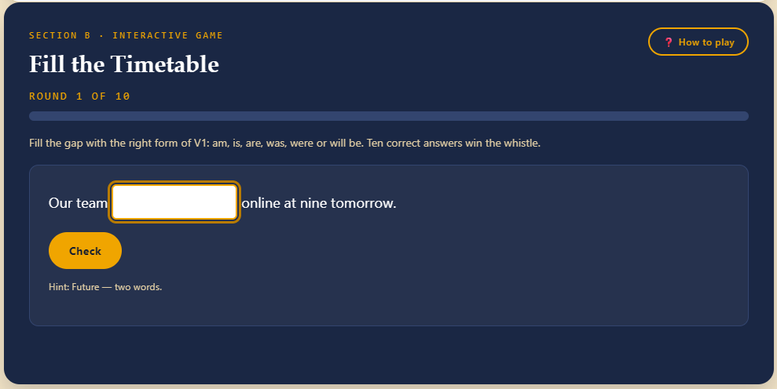
LOCATION 4 OF 9 · HOW TO PLAY
Santa Susana Depot
Six words, three times, no exceptions
HOW TO PLAY
Fill the gap with the right form of V1: am, is, are, was, were or will be. Ten correct answers win the whistle.
EXAMPLE
The proposal ___ ready for Monday. → is (present, singular subject).
Hidden object: Iron Rail Whistle 🚂
The Nine Keys of Simi Valley · Student Guide
23

Slide 24
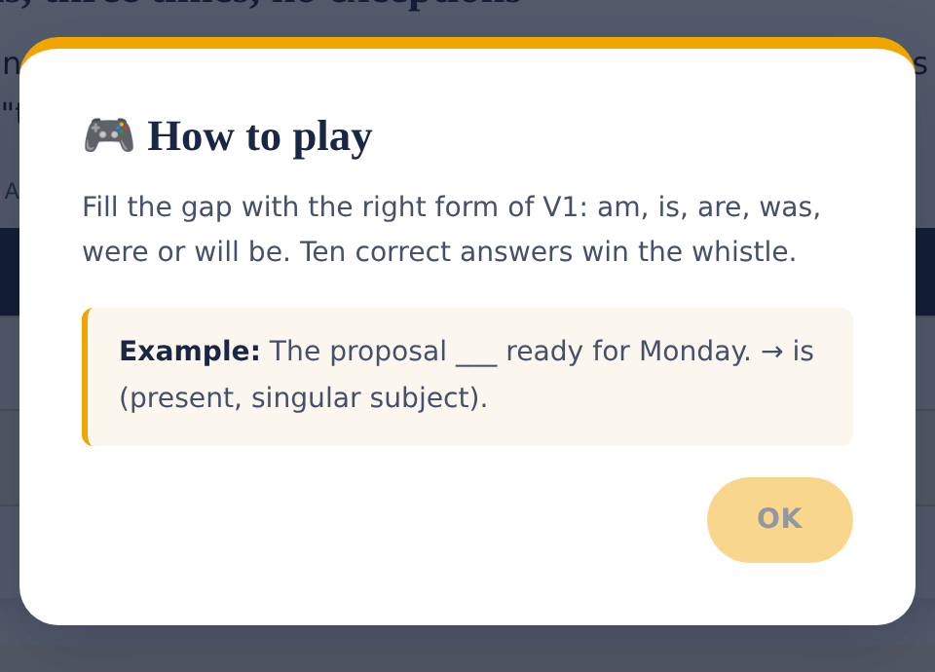
LOCATION 4 OF 9 · HELP, ANYTIME
Santa Susana Depot
Six words, three times, no exceptions
The “How to play” button beside the game reopens this same popup at any point during a round — the mechanic and one worked example, without losing your progress.
The Nine Keys of Simi Valley · Student Guide
24

Slide 25
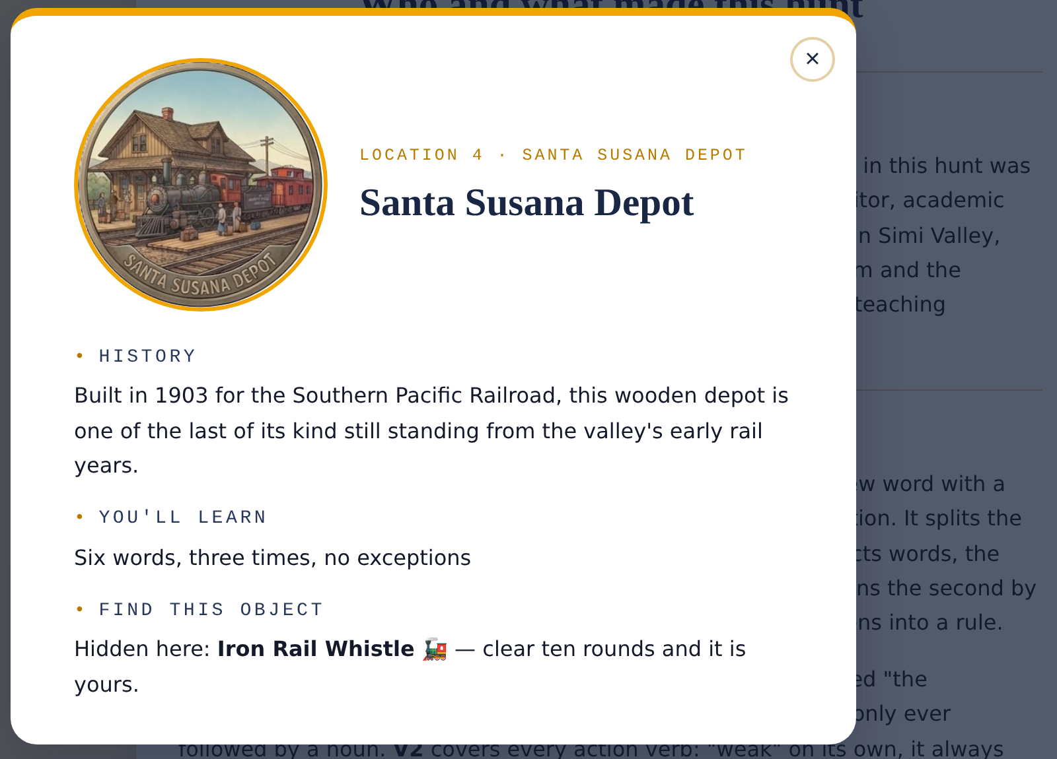
LOCATION 4 OF 9 · ABOUT THIS PLACE
Santa Susana Depot
Six words, three times, no exceptions
Tap the info icon (ℹ️) next to any location on the map to open this card — real history behind the place, the grammar topic waiting for you, and the object you are hunting for.
The Nine Keys of Simi Valley · Student Guide
25

Slide 26
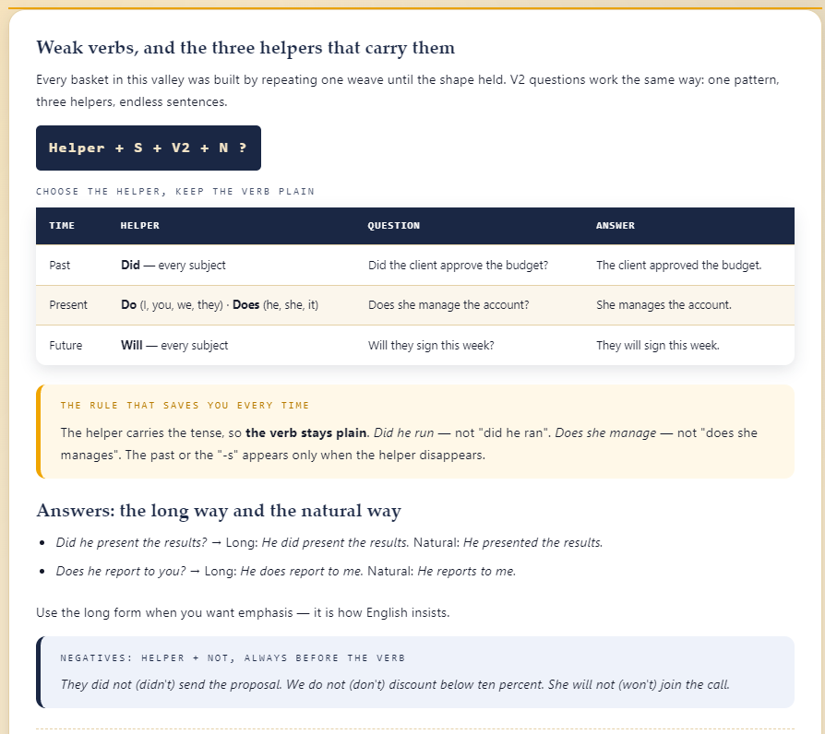
LOCATION 5 OF 9 · THE LESSON
Chumash Indian Museum
Weak verbs, and the three helpers that carry them
V2 verbs cannot ask their own questions — they borrow one of three helpers by tense: Did for the past, Do / Does for the present, Will for the future. The helper carries the tense, so the verb itself always stays in its plain form.
The Nine Keys of Simi Valley · Student Guide
26

Slide 27
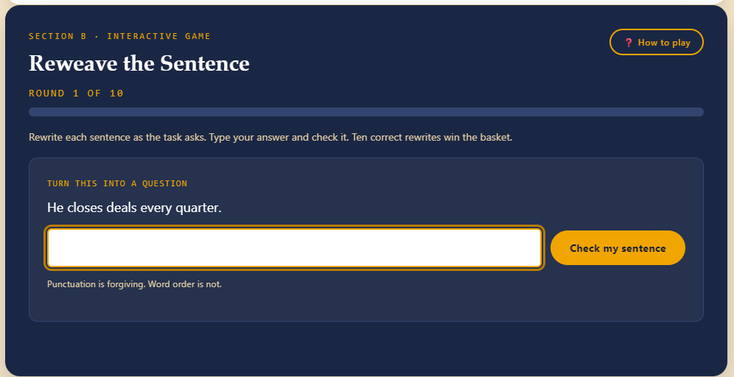
LOCATION 5 OF 9 · HOW TO PLAY
Chumash Indian Museum
Weak verbs, and the three helpers that carry them
HOW TO PLAY
Rewrite each sentence as the task asks. Type your answer and check it. Ten correct rewrites win the basket.
EXAMPLE
The client approved the budget. → Did the client approve the budget?
Hidden object: Valley Rain Basket 🧺
The Nine Keys of Simi Valley · Student Guide
27

Slide 28
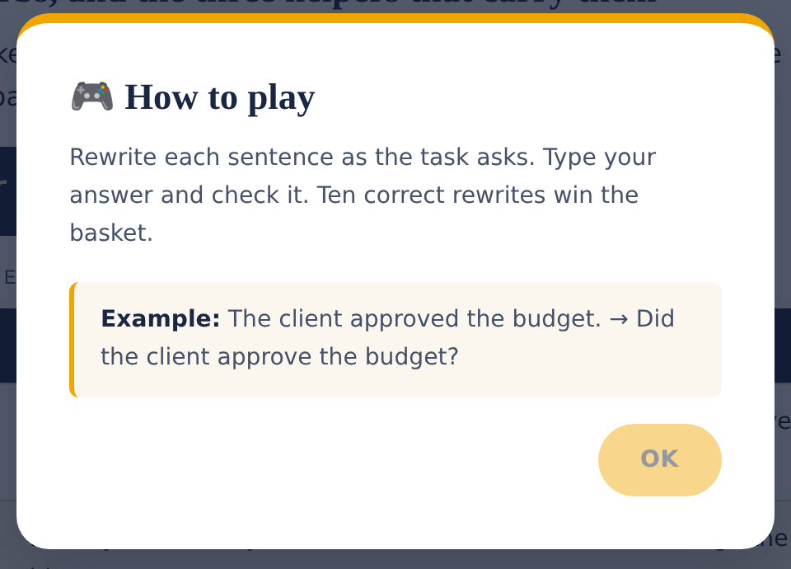
LOCATION 5 OF 9 · HELP, ANYTIME
Chumash Indian Museum
Weak verbs, and the three helpers that carry them
The “How to play” button beside the game reopens this same popup at any point during a round — the mechanic and one worked example, without losing your progress.
The Nine Keys of Simi Valley · Student Guide
28

Slide 29
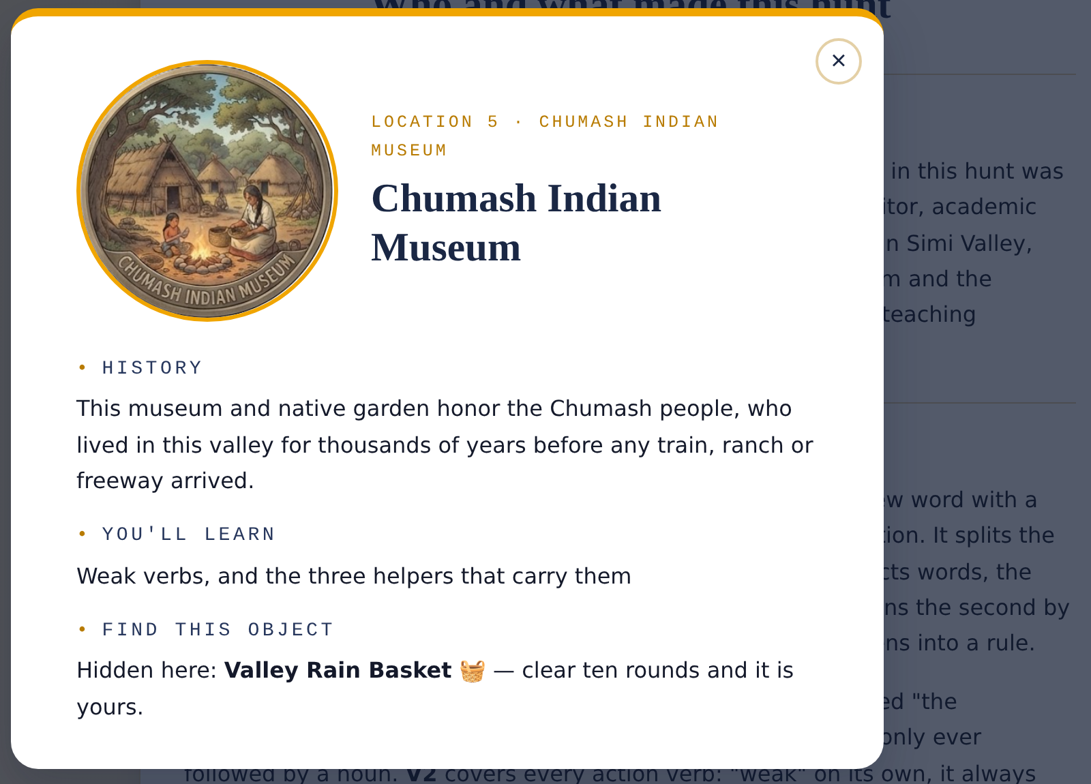
LOCATION 5 OF 9 · ABOUT THIS PLACE
Chumash Indian Museum
Weak verbs, and the three helpers that carry them
Tap the info icon (ℹ️) next to any location on the map to open this card — real history behind the place, the grammar topic waiting for you, and the object you are hunting for.
The Nine Keys of Simi Valley · Student Guide
29

Slide 30
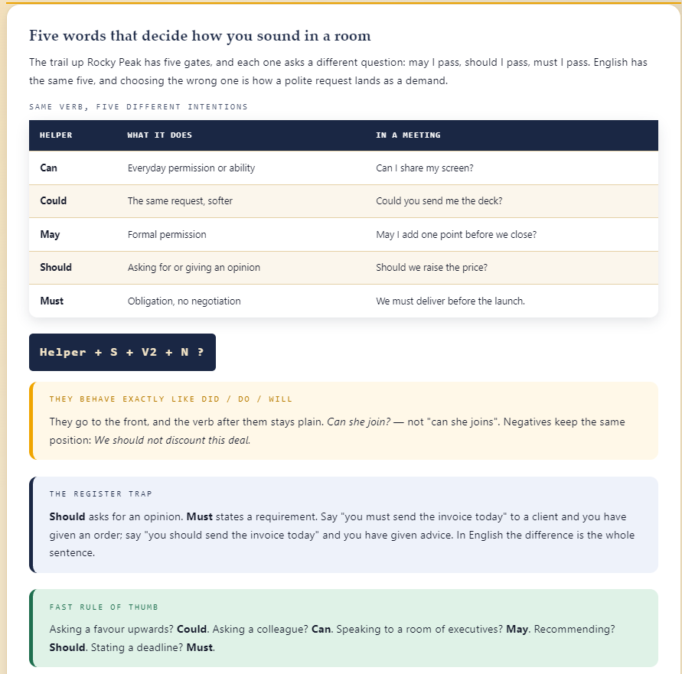
LOCATION 6 OF 9 · THE LESSON
Rocky Peak Park
Five words that decide how you sound in a room
Can, Could, May, Should and Must all touch permission or obligation, but each sets a different tone — from a casual favor to a hard deadline. Picking the wrong one is often what turns a polite request into an accidental order.
The Nine Keys of Simi Valley · Student Guide
30

Slide 31
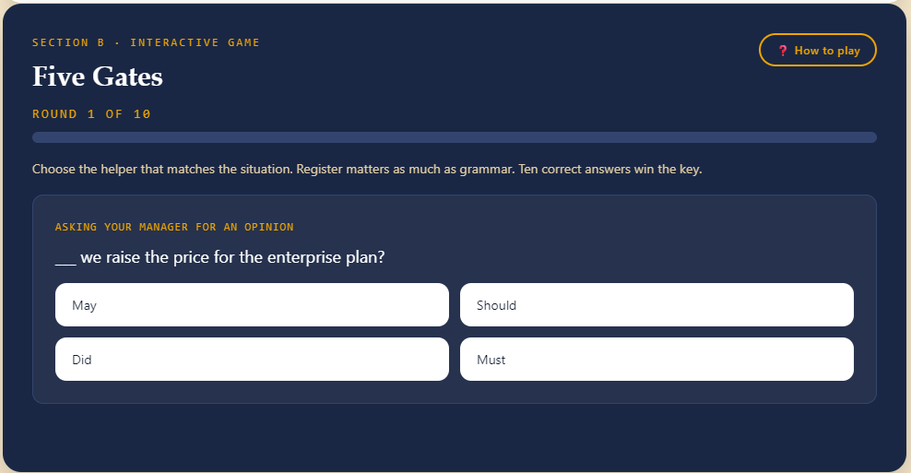
LOCATION 6 OF 9 · HOW TO PLAY
Rocky Peak Park
Five words that decide how you sound in a room
HOW TO PLAY
Choose the helper that matches the situation. Register matters as much as grammar. Ten correct answers win the key.
EXAMPLE
We ___ deliver the report before Friday. → must (a hard deadline, no room to negotiate).
Hidden object: Amber Sandstone Key 🗝️
The Nine Keys of Simi Valley · Student Guide
31

Slide 32
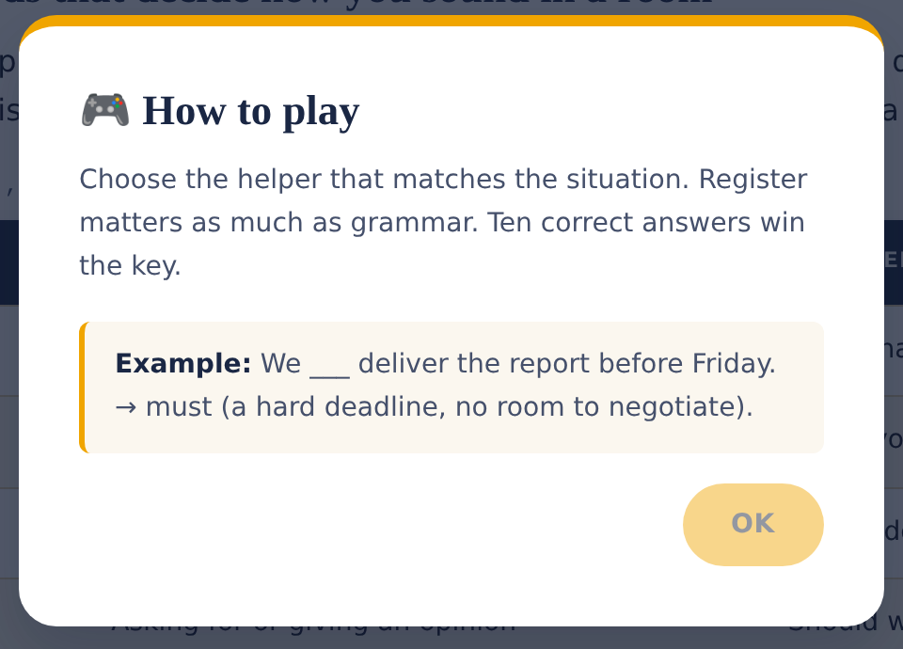
LOCATION 6 OF 9 · HELP, ANYTIME
Rocky Peak Park
Five words that decide how you sound in a room
The “How to play” button beside the game reopens this same popup at any point during a round — the mechanic and one worked example, without losing your progress.
The Nine Keys of Simi Valley · Student Guide
32

Slide 33
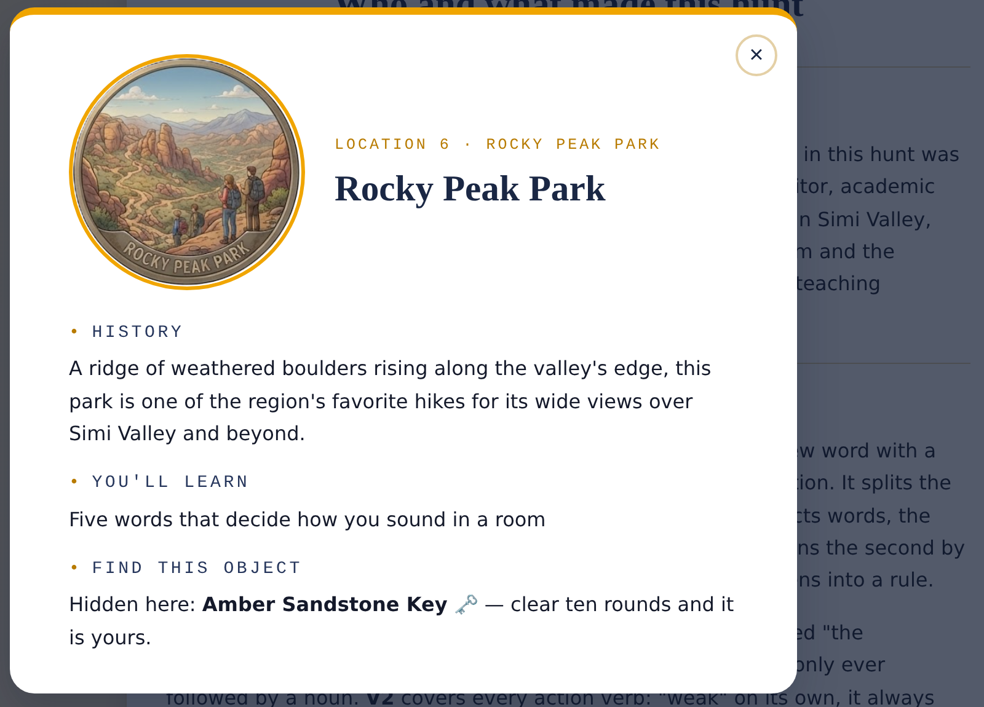
LOCATION 6 OF 9 · ABOUT THIS PLACE
Rocky Peak Park
Five words that decide how you sound in a room
Tap the info icon (ℹ️) next to any location on the map to open this card — real history behind the place, the grammar topic waiting for you, and the object you are hunting for.
The Nine Keys of Simi Valley · Student Guide
33

Slide 34
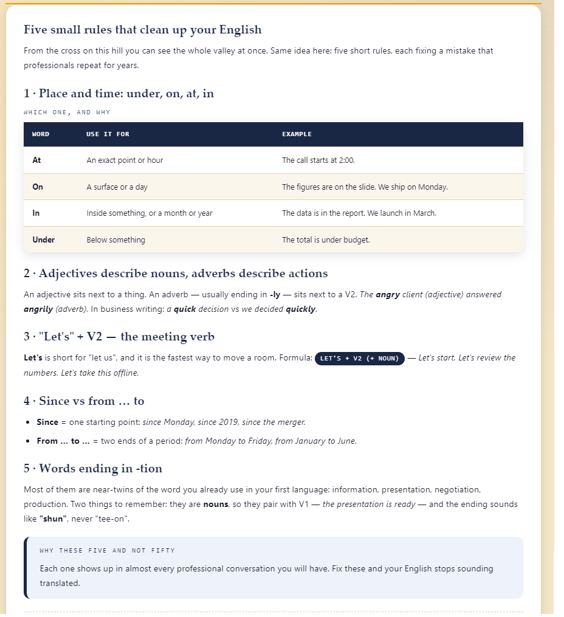
LOCATION 7 OF 9 · THE LESSON
Mount McCoy Cross
Five small rules that clean up your English
Five small, frequent fixes that instantly sound more professional: the right preposition for place and time (at / on / in / under), adjectives versus adverbs, “Let's + verb” for moving a meeting along, since versus from...to, and pronouncing -tion endings as “shun.”
The Nine Keys of Simi Valley · Student Guide
34

Slide 35
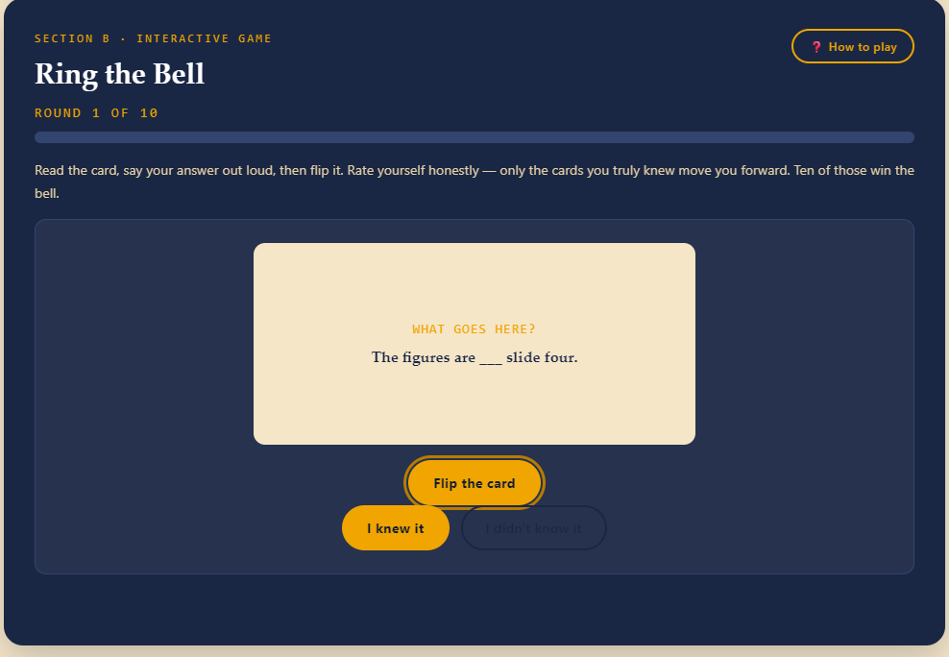
LOCATION 7 OF 9 · HOW TO PLAY
Mount McCoy Cross
Five small rules that clean up your English
HOW TO PLAY
Read the card, say your answer out loud, then flip it. Rate yourself honestly — only the cards you truly knew move you forward. Ten of those win the bell.
EXAMPLE
The call starts ___ 2:00. → at 2:00 (an exact point in time).
Hidden object: Hilltop Bell 🔔
The Nine Keys of Simi Valley · Student Guide
35

Slide 36
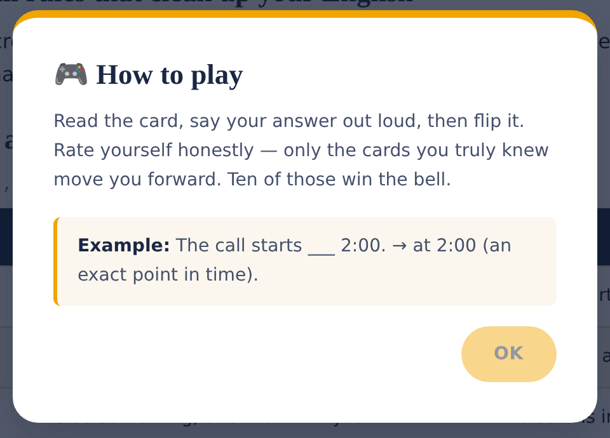
LOCATION 7 OF 9 · HELP, ANYTIME
Mount McCoy Cross
Five small rules that clean up your English
The “How to play” button beside the game reopens this same popup at any point during a round — the mechanic and one worked example, without losing your progress.
The Nine Keys of Simi Valley · Student Guide
36

Slide 37
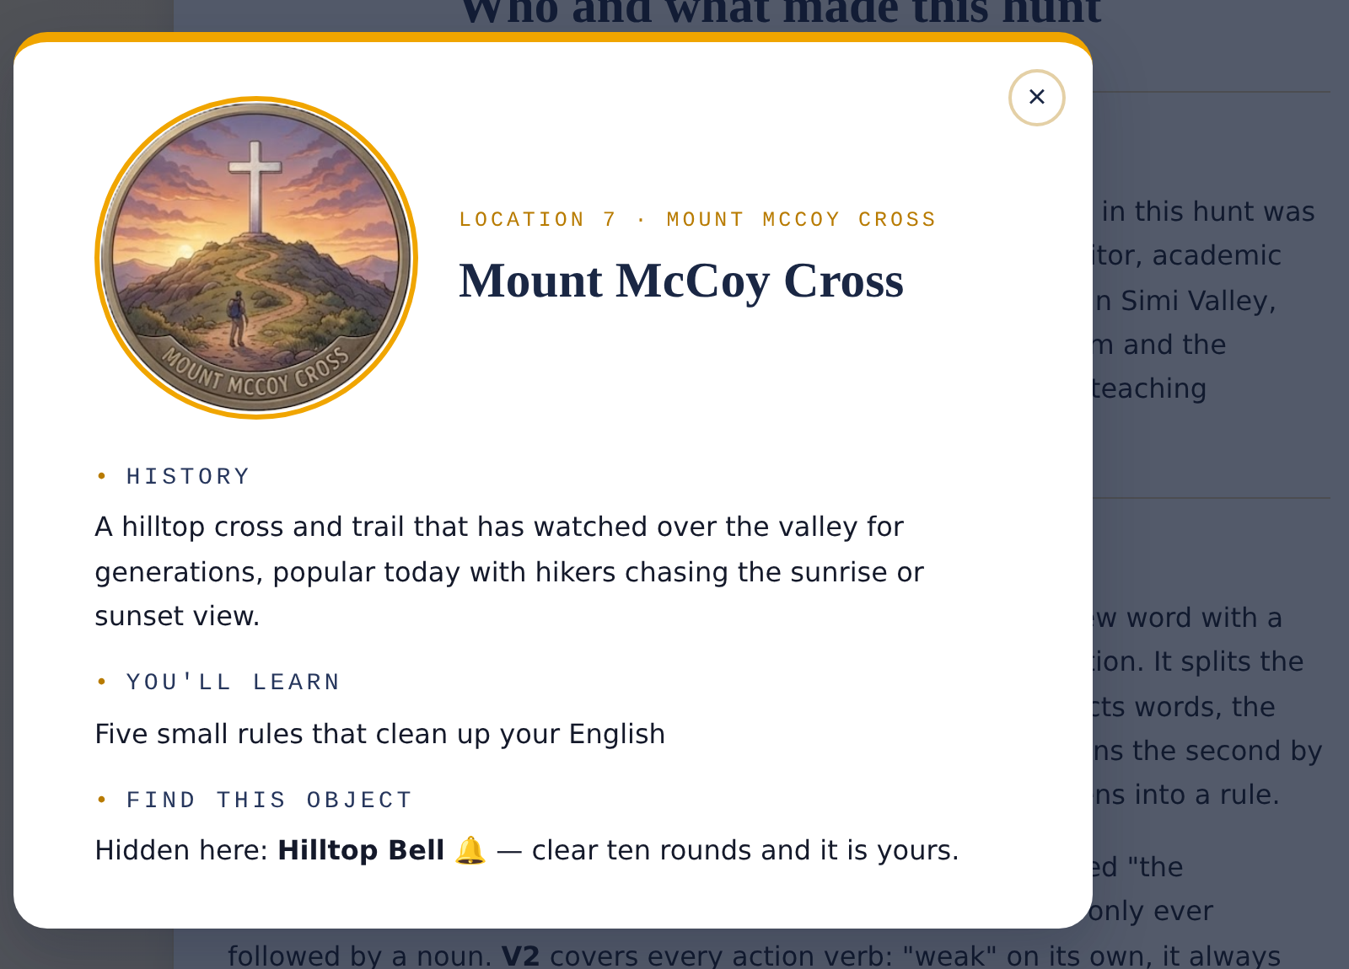
LOCATION 7 OF 9 · ABOUT THIS PLACE
Mount McCoy Cross
Five small rules that clean up your English
Tap the info icon (ℹ️) next to any location on the map to open this card — real history behind the place, the grammar topic waiting for you, and the object you are hunting for.
The Nine Keys of Simi Valley · Student Guide
37

Slide 38
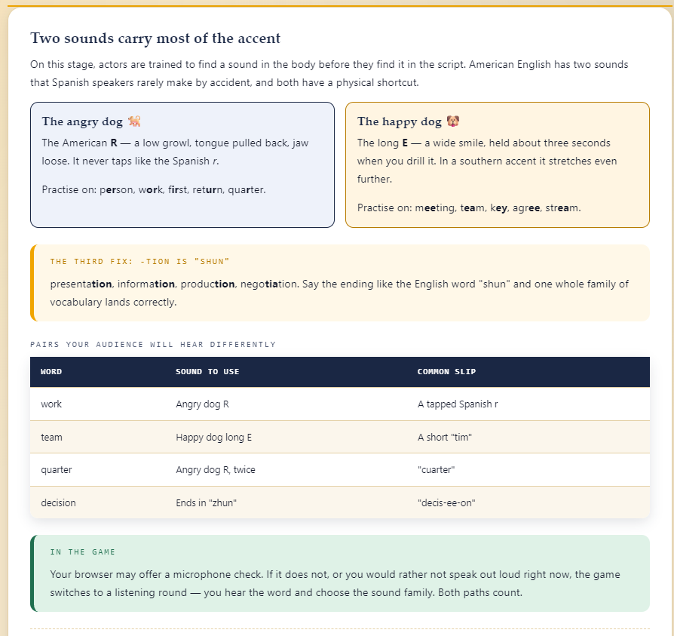
LOCATION 8 OF 9 · THE LESSON
Simi Valley Cultural Arts Center
Two sounds carry most of the accent
Two sounds do most of the work in an American accent: the growled English R and the wide, held long E. Both are physical habits more than pronunciation rules — and both are sounds Spanish speakers rarely make by accident.
The Nine Keys of Simi Valley · Student Guide
38

Slide 39
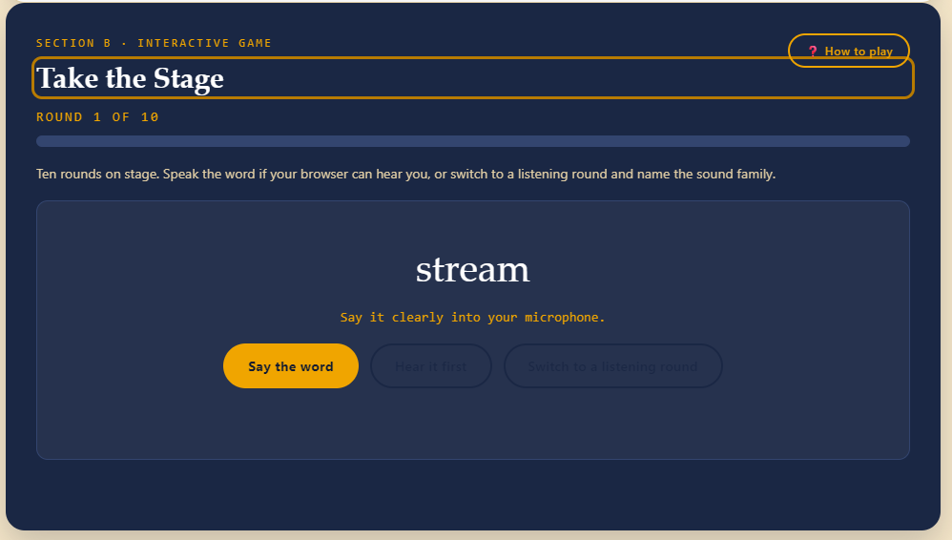
LOCATION 8 OF 9 · HOW TO PLAY
Simi Valley Cultural Arts Center
Two sounds carry most of the accent
HOW TO PLAY
Ten rounds on stage. Speak the word if your browser can hear you, or switch to a listening round and name the sound family.
EXAMPLE
quarter → Two growls: quar-ter (the Angry dog R).
Hidden object: Echo Stage Mask 🎭
The Nine Keys of Simi Valley · Student Guide
39

Slide 40
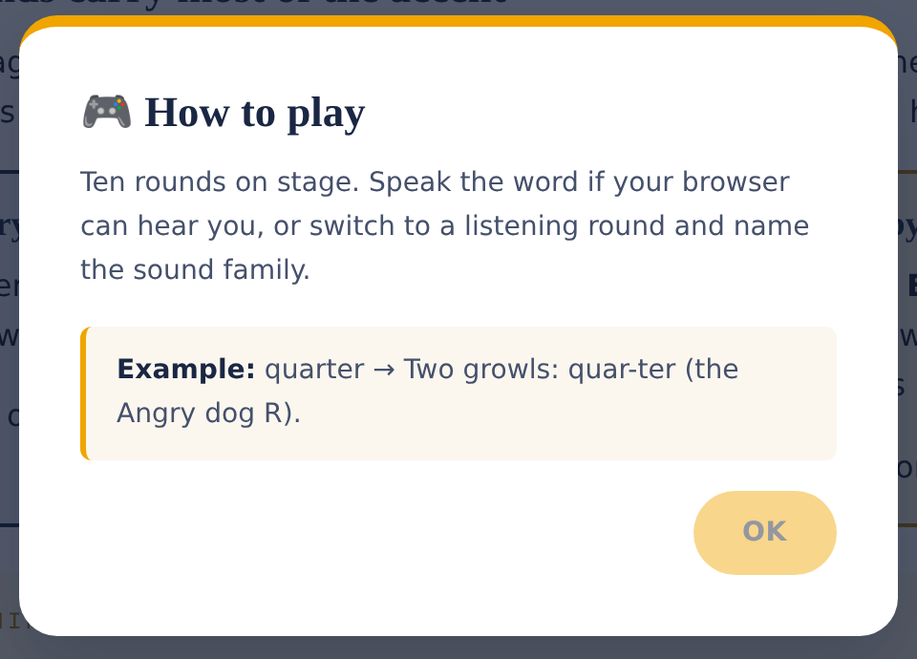
LOCATION 8 OF 9 · HELP, ANYTIME
Simi Valley Cultural Arts Center
Two sounds carry most of the accent
The “How to play” button beside the game reopens this same popup at any point during a round — the mechanic and one worked example, without losing your progress.
The Nine Keys of Simi Valley · Student Guide
40

Slide 41
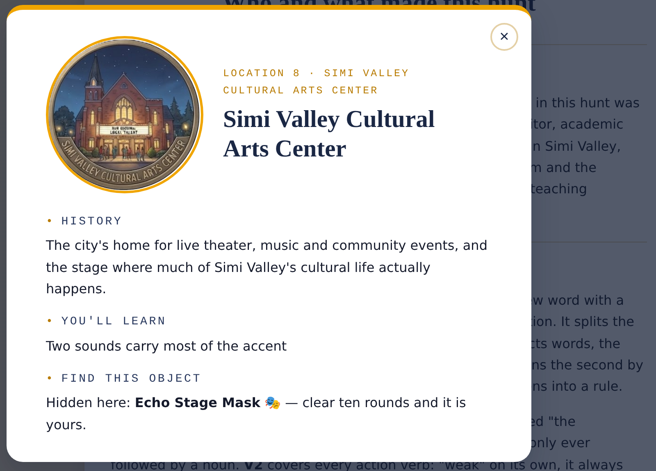
LOCATION 8 OF 9 · ABOUT THIS PLACE
Simi Valley Cultural Arts Center
Two sounds carry most of the accent
Tap the info icon (ℹ️) next to any location on the map to open this card — real history behind the place, the grammar topic waiting for you, and the object you are hunting for.
The Nine Keys of Simi Valley · Student Guide
41

Slide 42
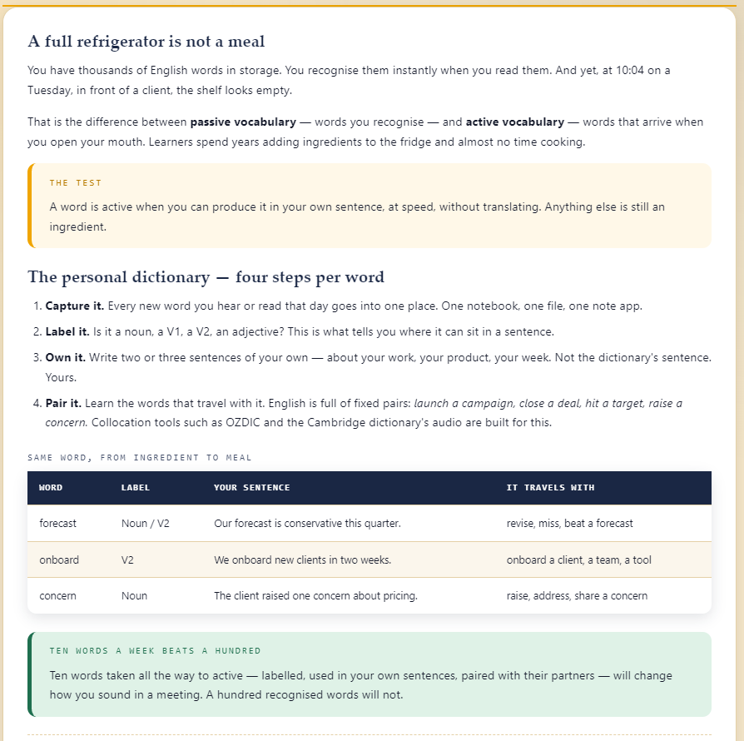
LOCATION 9 OF 9 · THE LESSON
Rancho Simi Community Park
A full refrigerator is not a meal
Recognizing a word (passive vocabulary) is not the same as producing it on the spot (active vocabulary). The personal dictionary technique — capture it, label it, own it with your own sentence, then pair it with the words it travels with — is how a word makes that move.
The Nine Keys of Simi Valley · Student Guide
42

Slide 43
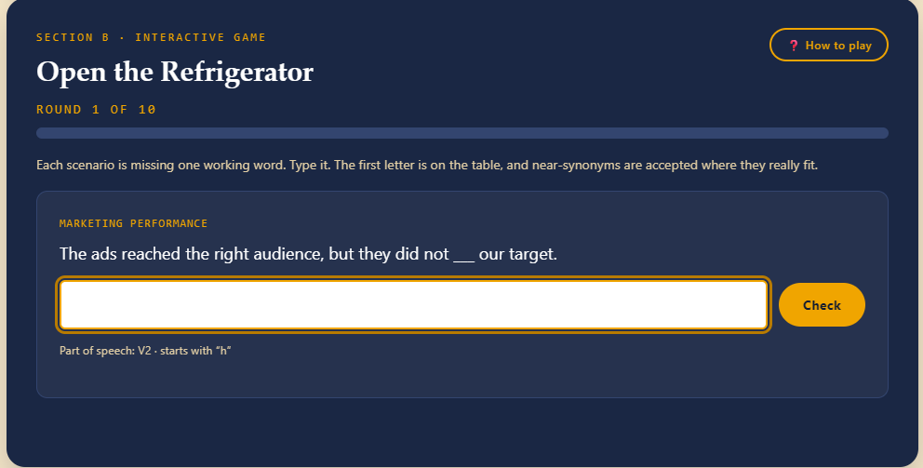
LOCATION 9 OF 9 · HOW TO PLAY
Rancho Simi Community Park
A full refrigerator is not a meal
HOW TO PLAY
Each scenario is missing one working word. Type it. The first letter is on the table, and near-synonyms are accepted where they really fit.
EXAMPLE
Sales came in below plan, so we had to revise the ___ for the next two quarters. → forecast (Noun).
Hidden object: Yucca Seed Medallion 🌿
The Nine Keys of Simi Valley · Student Guide
43

Slide 44
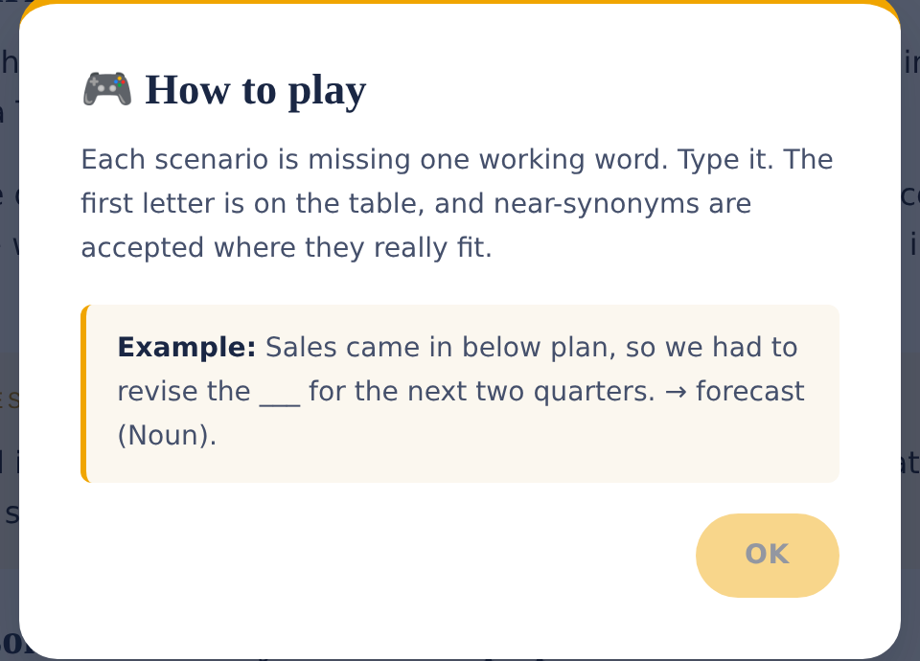
LOCATION 9 OF 9 · HELP, ANYTIME
Rancho Simi Community Park
A full refrigerator is not a meal
The “How to play” button beside the game reopens this same popup at any point during a round — the mechanic and one worked example, without losing your progress.
The Nine Keys of Simi Valley · Student Guide
44

Slide 45
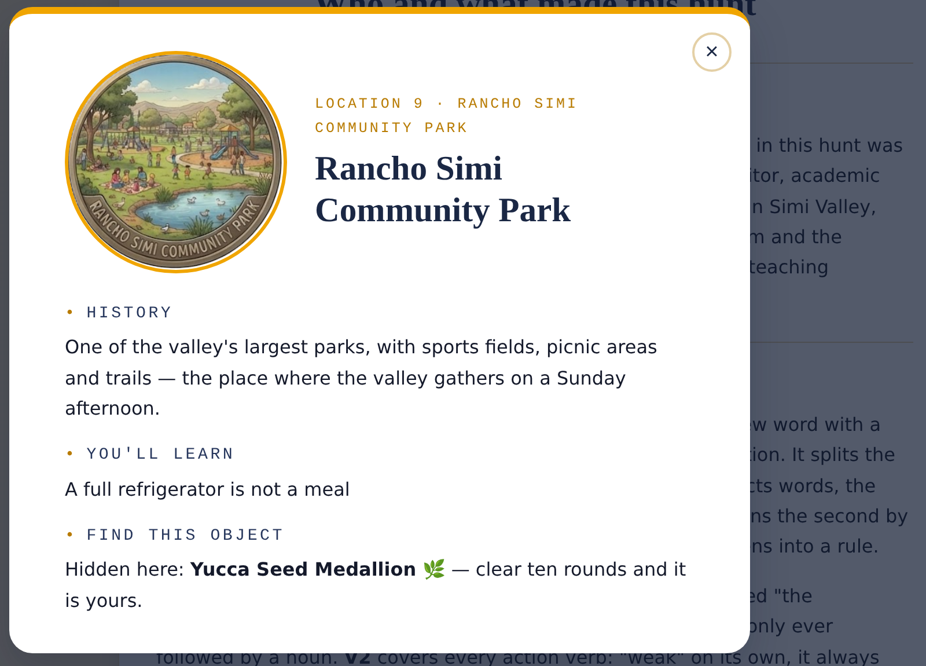
LOCATION 9 OF 9 · ABOUT THIS PLACE
Rancho Simi Community Park
A full refrigerator is not a meal
Tap the info icon (ℹ️) next to any location on the map to open this card — real history behind the place, the grammar topic waiting for you, and the object you are hunting for.
The Nine Keys of Simi Valley · Student Guide
45

Slide 46
5
TRACK YOUR PROGRESS
Objects Found in the top bar always shows how many of the nine you have collected.
Switch the interface language at any time with the EN / ES / PT toggle in the top right.
Your progress is saved automatically as you complete each location — nothing to click to save.
The Nine Keys of Simi Valley · Student Guide
46

Slide 47

LANGUAGE SUPPORT
Lessons translate. The games don't.
Every grammar lesson can be read in English, Spanish, or Portuguese — switch anytime with the EN / ES / PT toggle in the top bar.
The nine mini-games stay in English on purpose: the whole point is producing English on the spot, not translating it first.
Use the translation to understand a rule fully in your own language, then play the round itself in English.
EN · ES · PT
The Nine Keys of Simi Valley · Student Guide
47

Slide 48
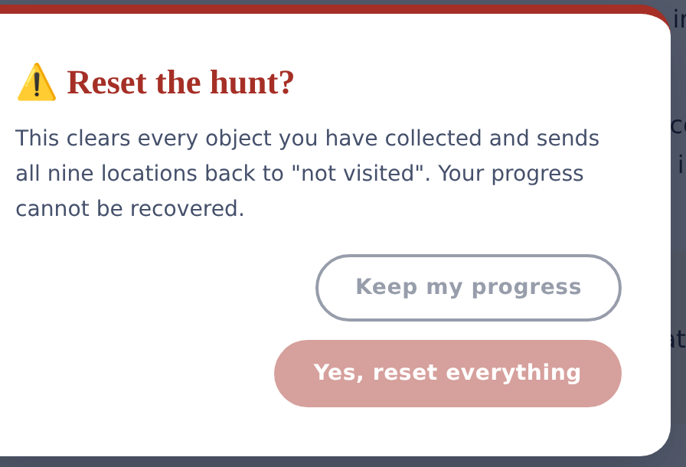
STARTING OVER
Resetting the hunt
The Reset Hunt button, top right, clears every object you have collected.
All nine locations return to Not visited, as if you were starting fresh.
A confirmation dialog always asks first — nothing resets by accident.
⚠ This action cannot be undone. Use it only when you want a completely fresh run.
The Nine Keys of Simi Valley · Student Guide
48

Slide 49
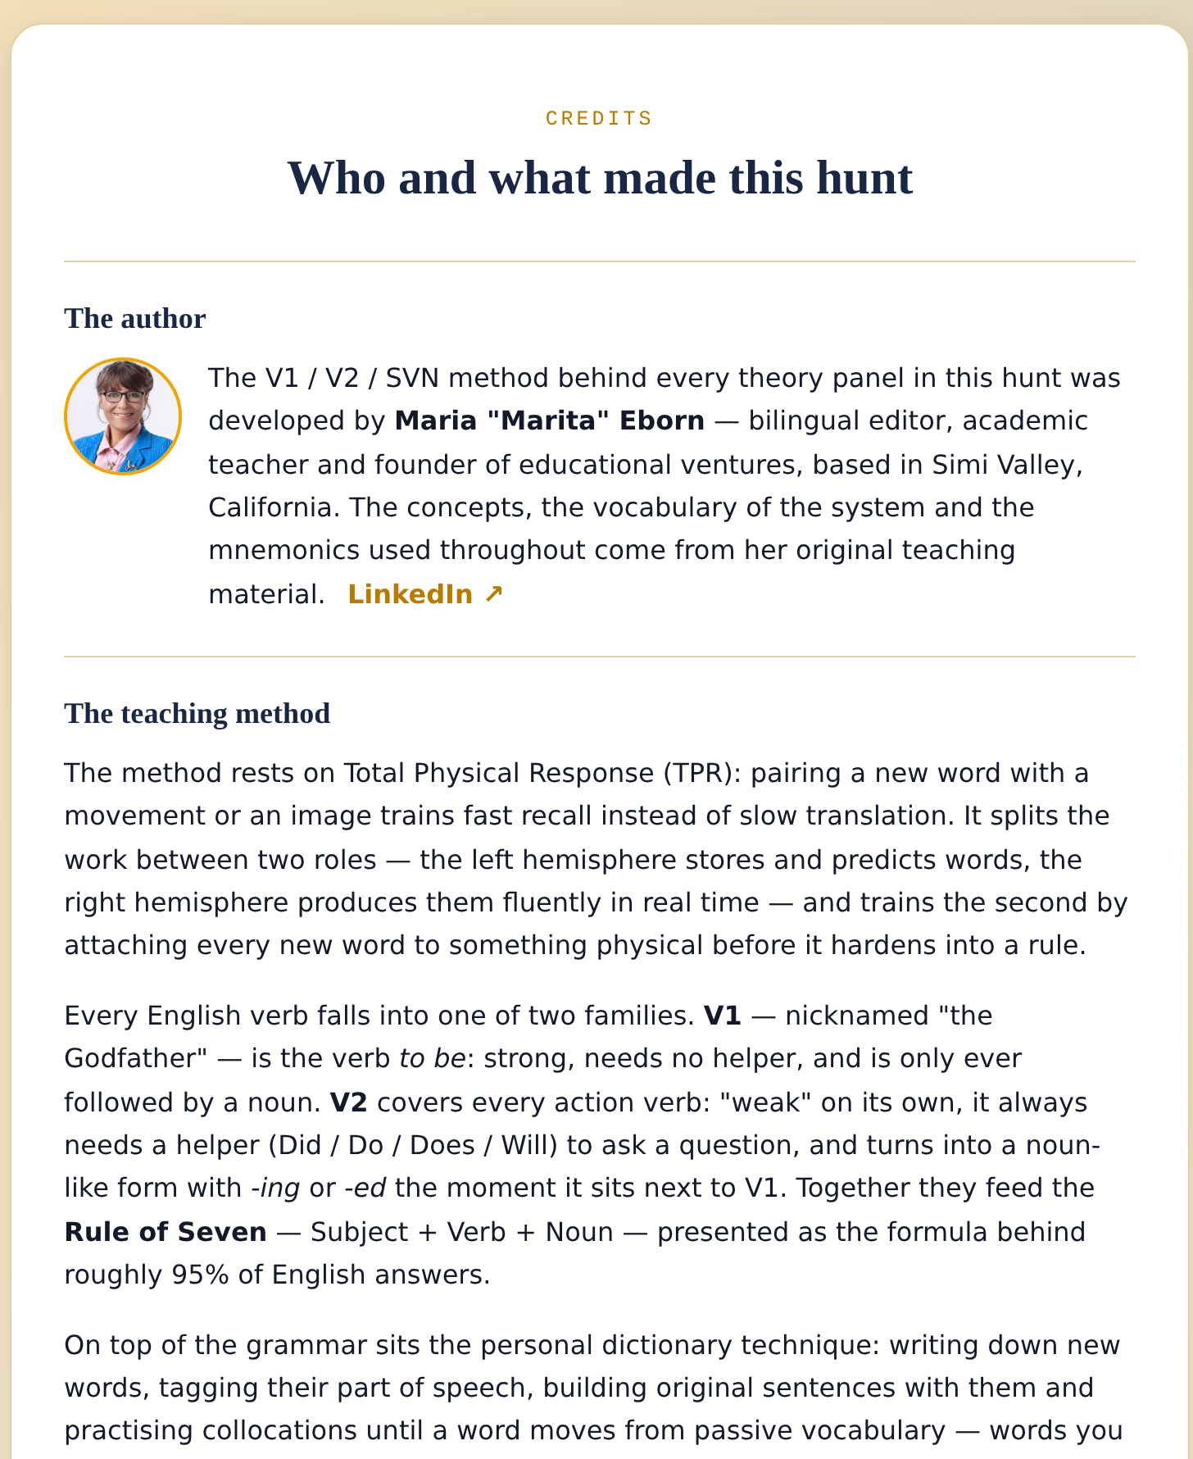
CREDITS
The method behind
every lesson
The V1 / V2 / SVN method was developed by Maria “Marita” Eborn, a bilingual editor and academic teacher based in Simi Valley, California.
It rests on Total Physical Response (TPR): pairing new words with movement or imagery for fast, natural recall.
On top of the grammar sits a personal dictionary technique — capture, label, own, and pair every new word until it becomes active vocabulary.
The Nine Keys of Simi Valley · Student Guide
49

Slide 50
QUICK REFERENCE
Five steps, every location
1
Choose a location
Open the map, pick any of the nine cards, and click Explore.
2
Learn about it
Open the info card to read the history and preview the topic.
3
Read How to play
Check the popup so the mechanic is clear before round one.
4
Study, then play
Read the short lesson, then clear ten rounds in Section B.
5
Track & switch
Watch Objects Found, and change language whenever you like.
The Nine Keys of Simi Valley · Student Guide
50

Slide 51
Nine locations. Nine lessons.
One word waiting.
Open the map and start whenever you are ready — in any order you like.
manu-data-master.github.io/V1V2FluencyEnglish.app
Good luck, student.

